Slide 1


CAT Progress Meeting
Western area Fields
Fri 27-Sept-2024

Slide 2
1- Inspection Cat

Slide 3
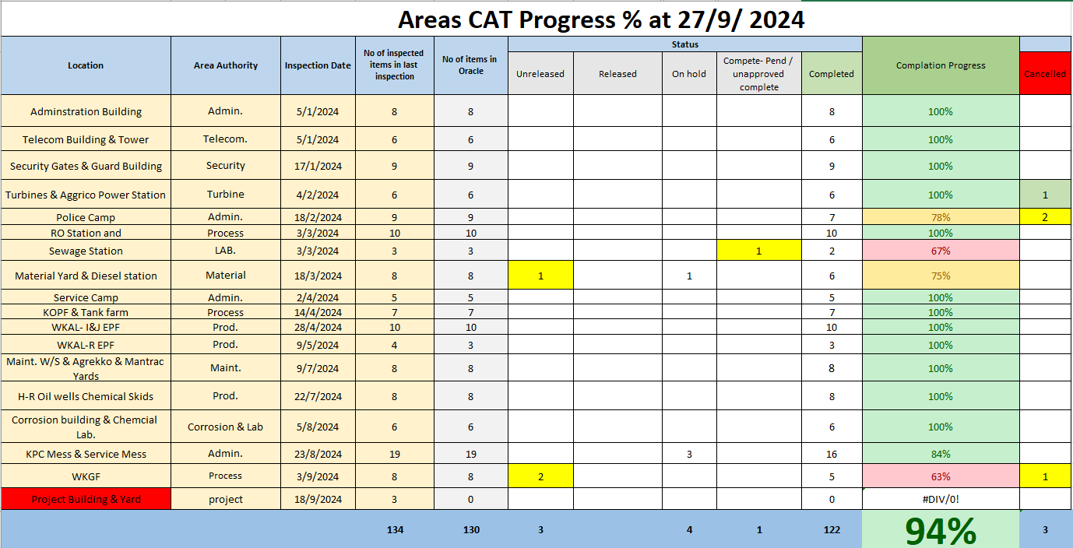

Slide 4
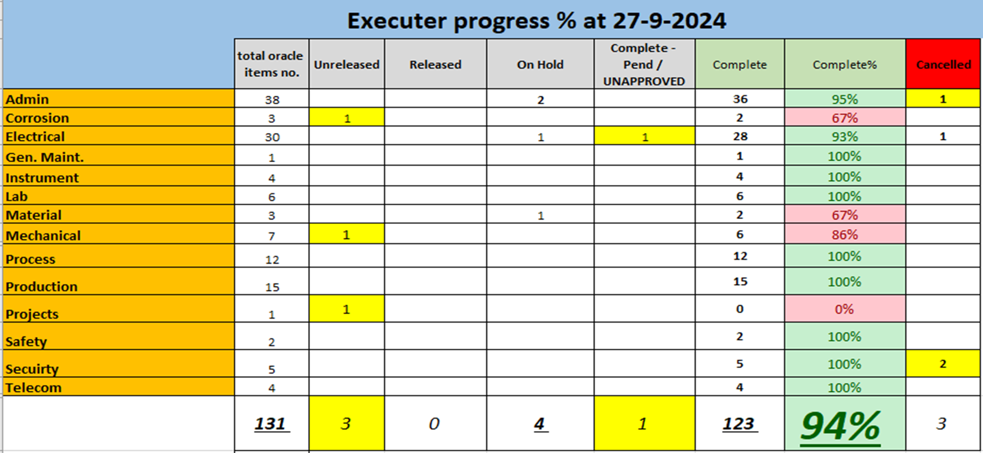
Executer Department Progress %

Slide 6
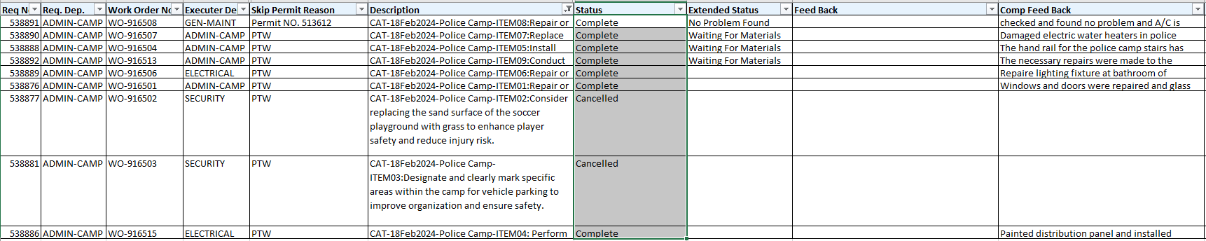
Security : Cancel items without justification

Slide 7
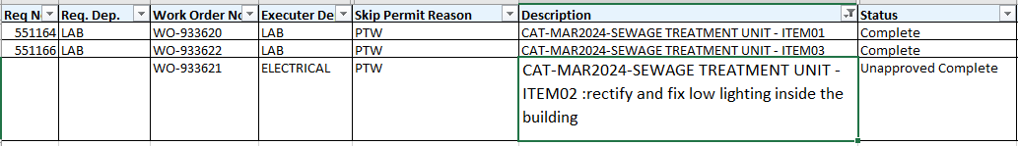
Electric : Unapproved Complete

Slide 8
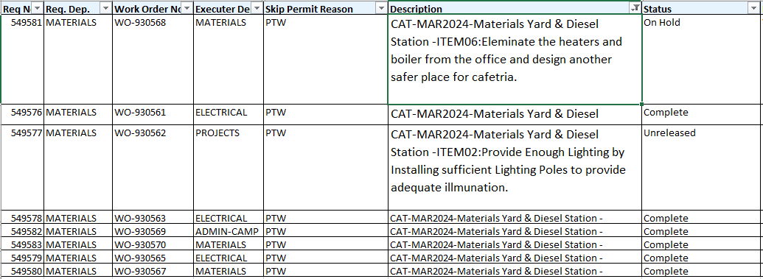
Material: unreleased & On-hold

Slide 9
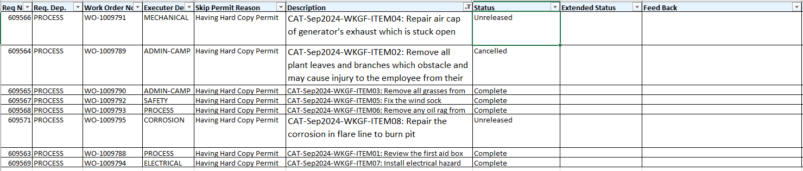
Mechanic & corrosion: Unreleased Admin: Cancel without feedback justification

Slide 10
Inspect. Plans (19-20-21-22-23) On Hold items progress @ 27-Sept-2024

Slide 11
Oracle system notes
WORK REQUEST : Code :
The correct code should be CAT-Date-Location-ITEM No.
( Date-location- Item No as written in the CAT Audit Report).
Ex: CAT-Aug2022-Location-ITEM00:
Wrong :CAT-AUG-2022 , Right : CAT-AUG2022
Wrong :CAT-Feb.-2022-location , Right : CAT-Feb2022-Service Camp
Wrong : CAT-SEP21- , Right : CAT-SEP2021-
Feedback in case of On hold must be clear where some feedback didn’t identify the reason properly , it must be clear on hold feedback on material or AR or other to facilitate track and solve.

Slide 12
2-SOC CAT

Slide 13
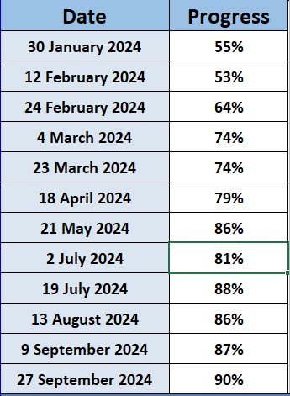
SOC CAT Progress YTD 2024

Slide 14
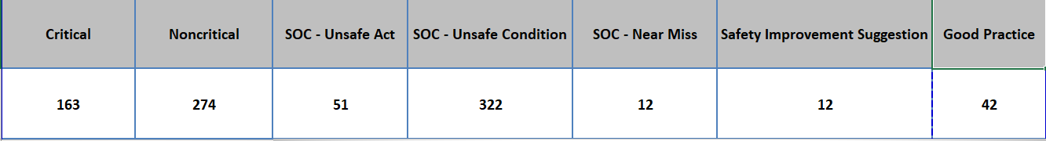
SOC Numbers Per Category

Slide 15
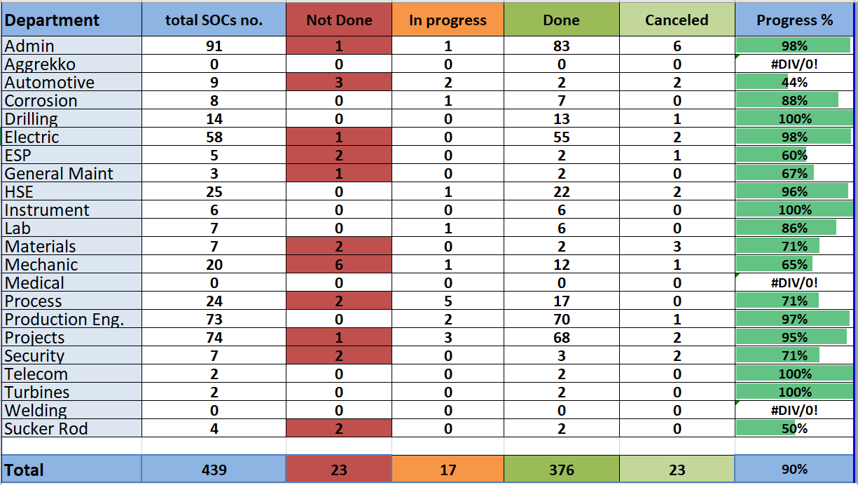
SOC Department CAT Progress

Slide 16
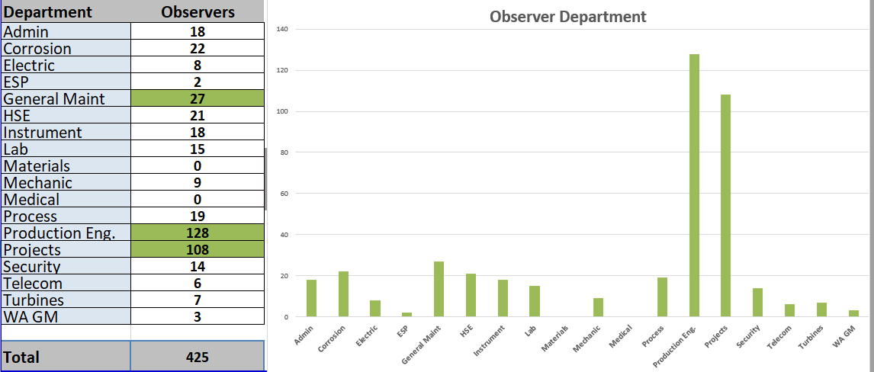
SOC Creation by Department & Observer

Slide 17
3-Walkthrough CAT

Slide 18
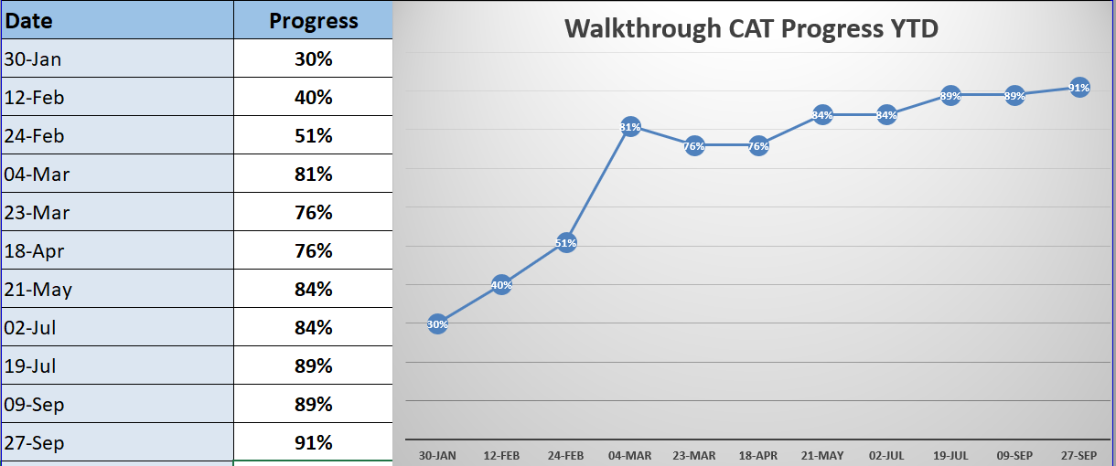
Walkthrough CAT Progress YTD

Slide 19
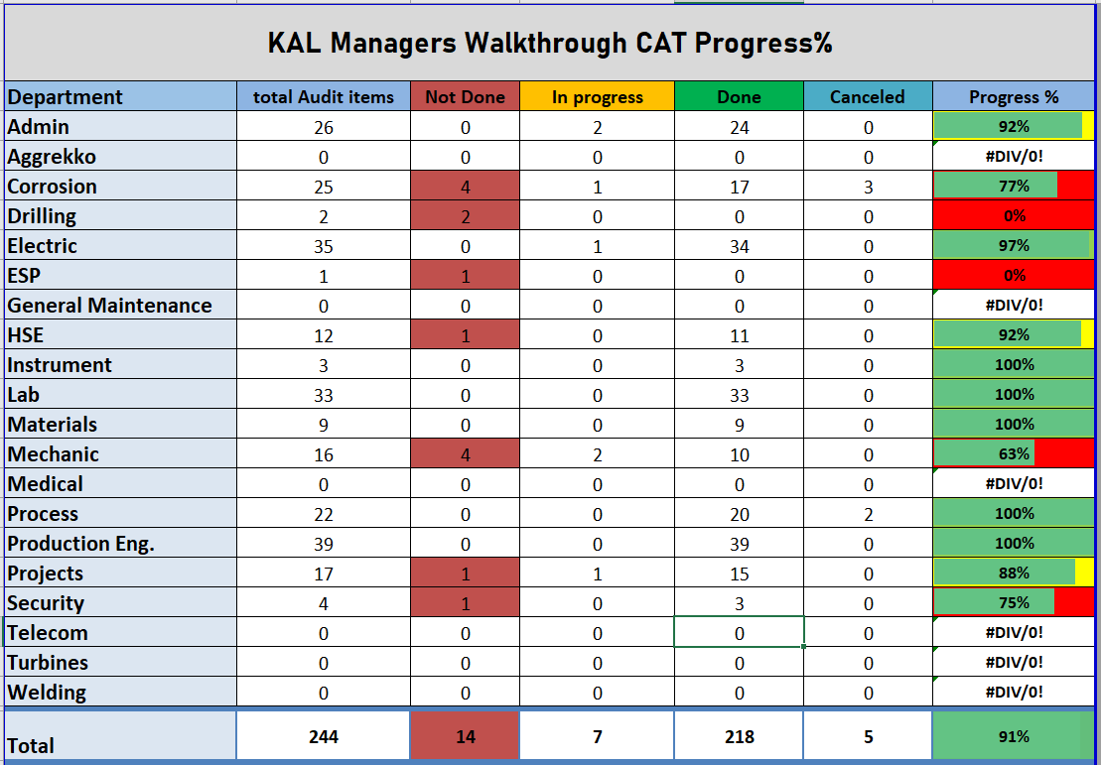

Slide 20
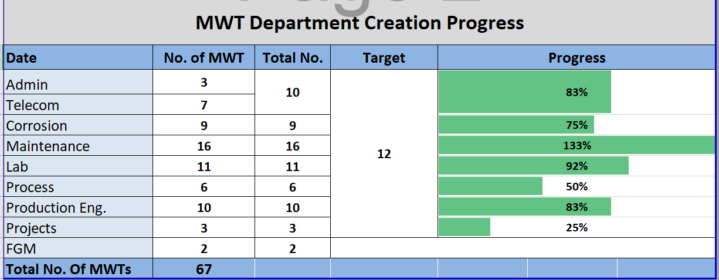

Slide 21


4-

Slide 22
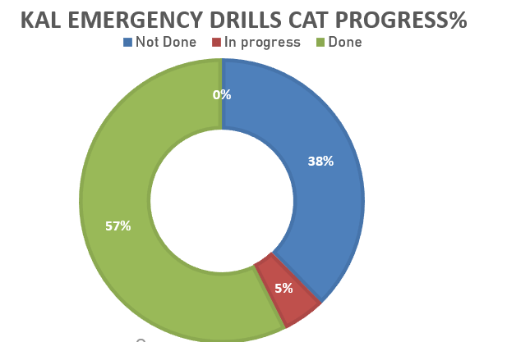

Slide 23
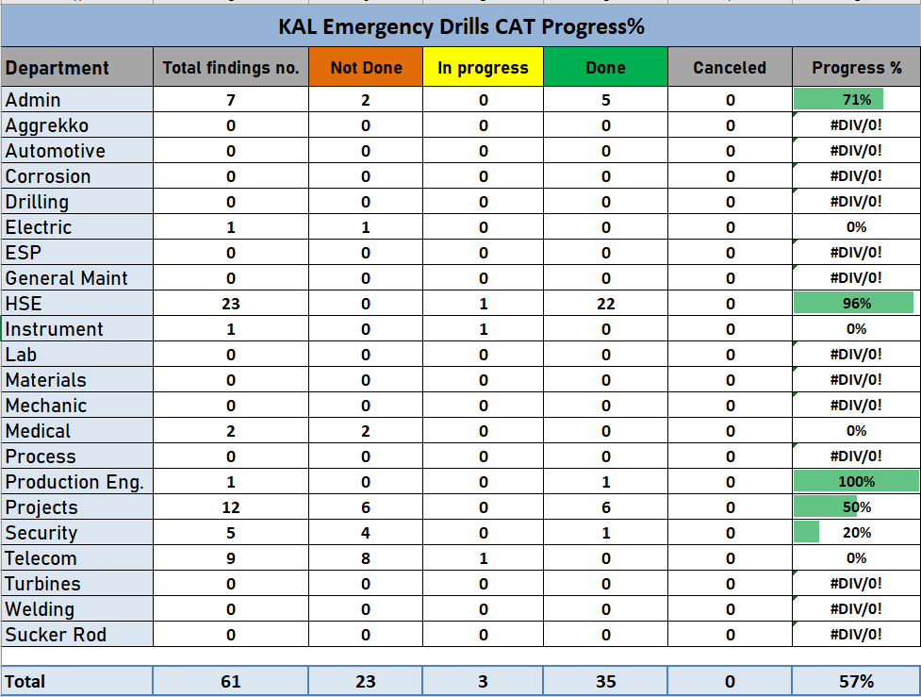

Slide 24
5-TOTAL CAT Progress

Slide 25

General Overview on CAT Progress %

Slide 26
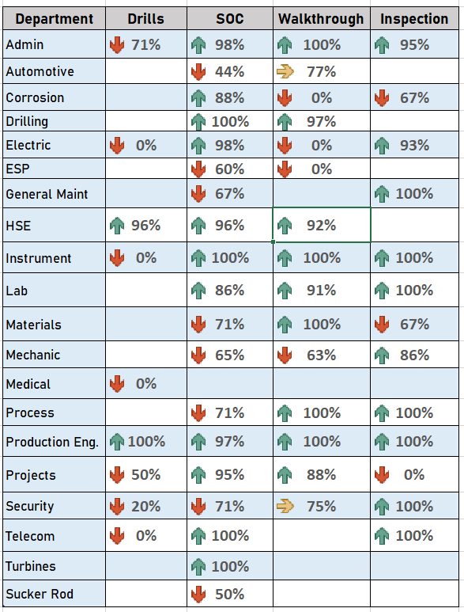
General Overview on Department CAT Progress %

Slide 27


